Slide 1
Client-Server communication in C#

Slide 2
Agenda
The end goal
Client <-> Server socket communication

Slide 3
Where we want to end up

Slide 4
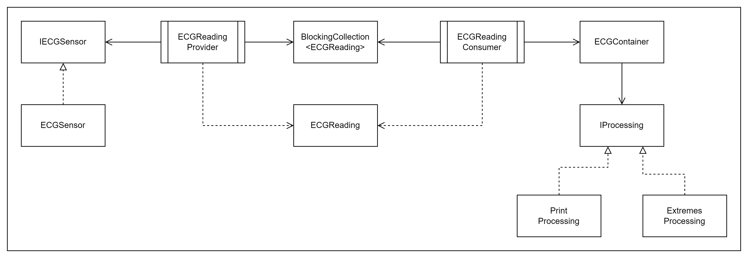
We want to go from this

Slide 5
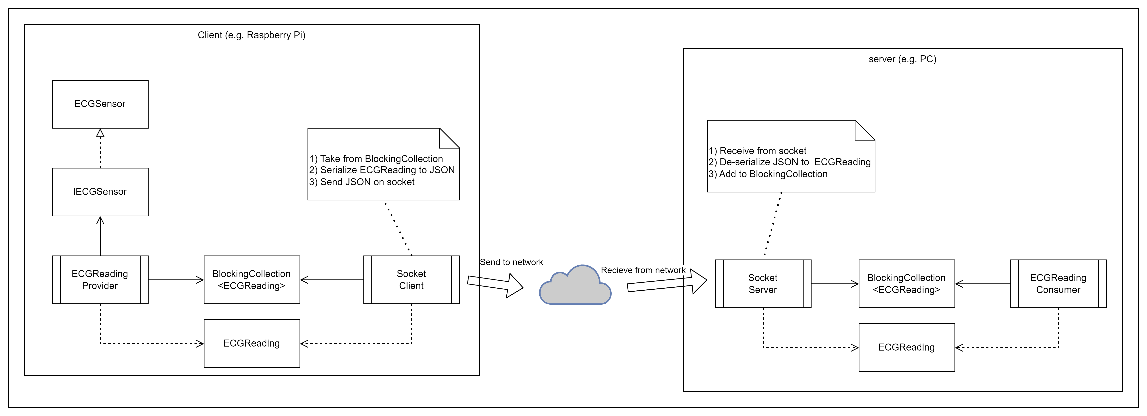
To this

Slide 6
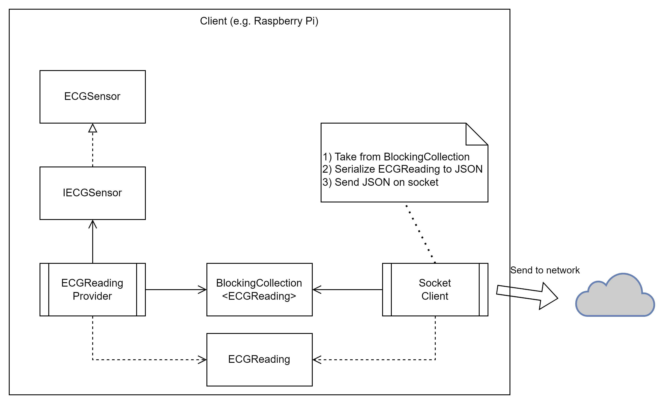
Client

Slide 7
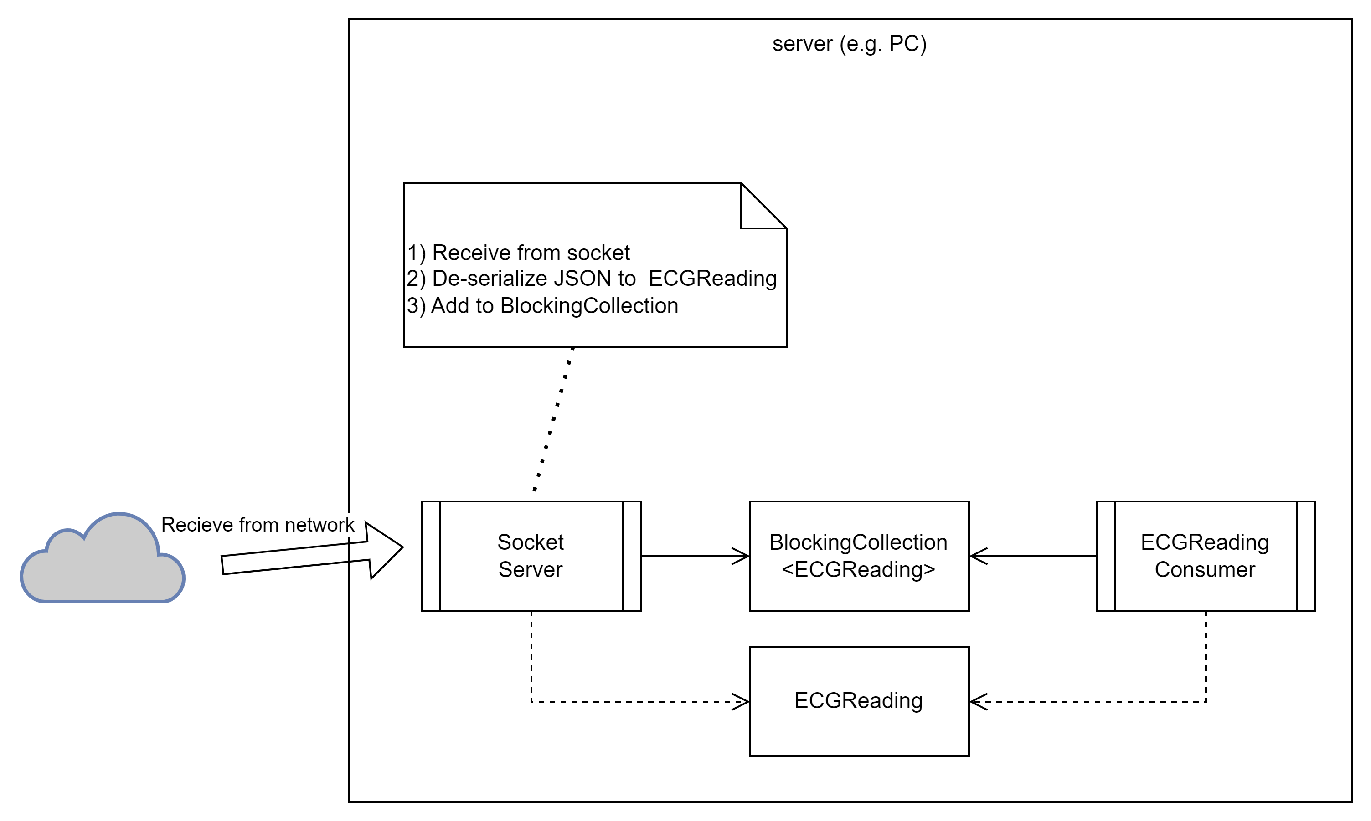
Server

Slide 8
Socket communication

Slide 9
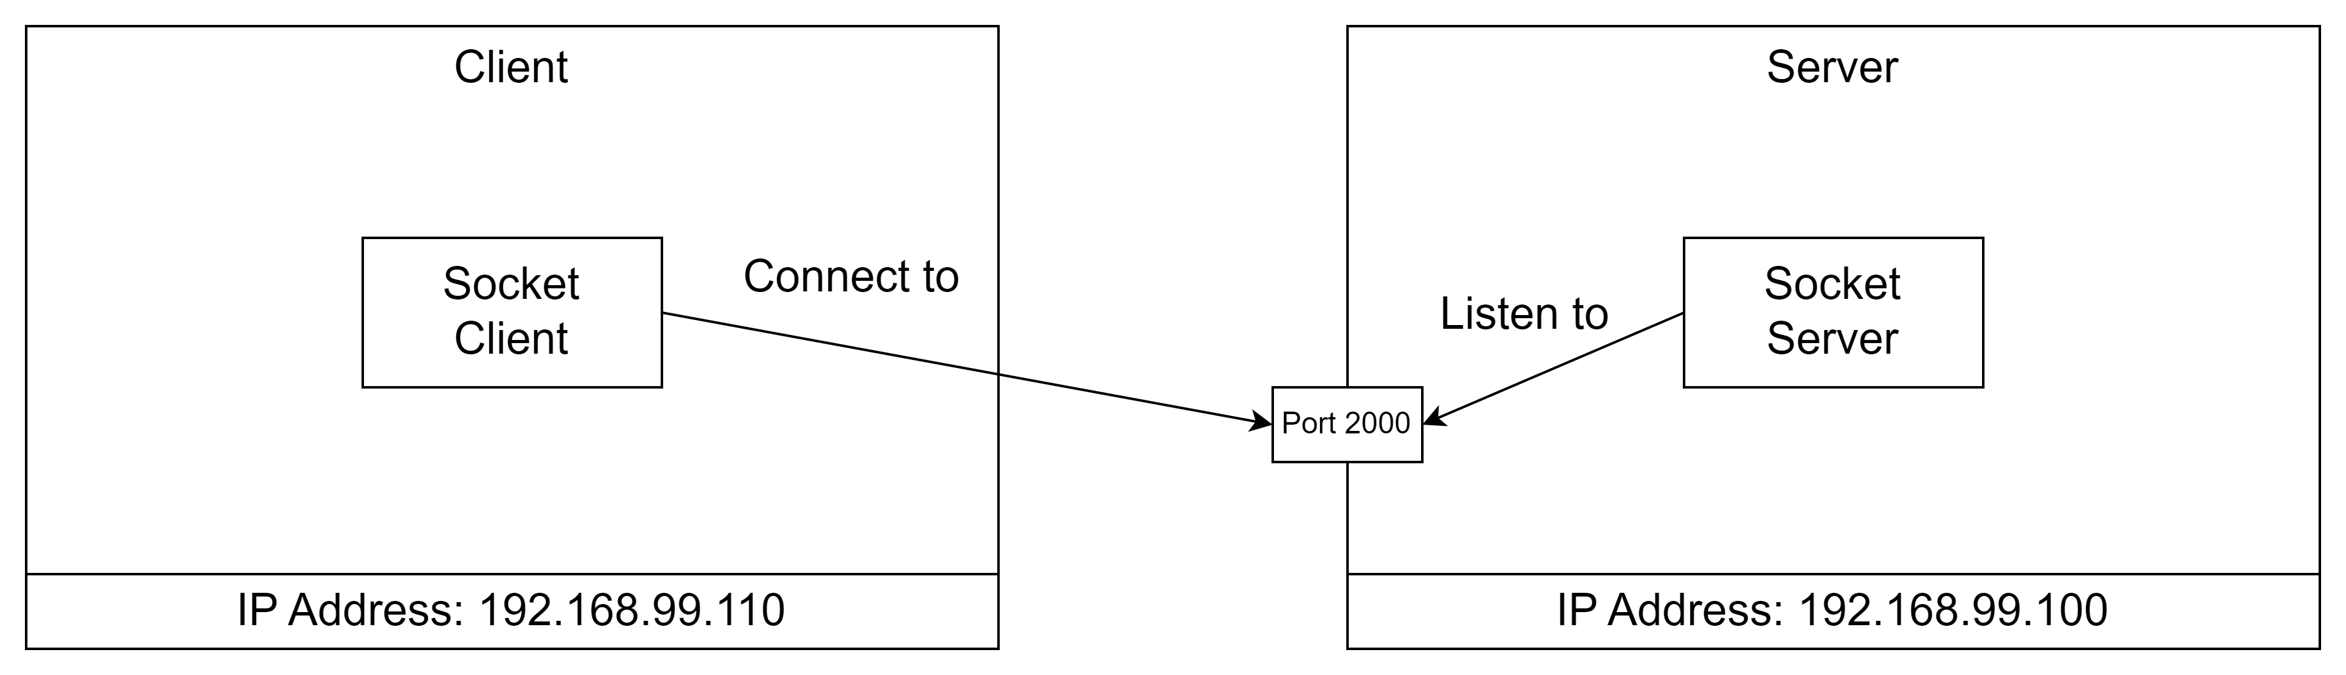
The server listens
The Server specifies where to listen:
IP Address
Port number

Slide 10
The server listens
The server can have multiple network cards and more than one address.
IP Address to listen to can be:
Any <= all network interfaces
Loopback <= 127.0.0.1
A specific IP address
The Server specifies where to listen:
IP Address
Port number

Slide 11
The client connects to the server
The client connects to a server socket:
IP Address
Port number

Slide 12
SocketServer
class SocketServer
{
public void RunServer()
{
// listen to 'Any' which means all network addresses for this machine
IPAddress ipAddress = IPAddress.Any;
IPEndPoint ipEndPoint = new IPEndPoint(ipAddress, 2000);
using Socket listener = new Socket(ipEndPoint.AddressFamily, SocketType.Stream, ProtocolType.Tcp);
listener.Bind(ipEndPoint);
Console.WriteLine($"Listening on: {ipAddress}");
listener.Listen();
var handler = listener.Accept();
while (true)
{
byte[] buffer = new byte[1024];
int numberOfBytesReceived = handler.Receive(buffer, SocketFlags.None);
string receivedData = Encoding.UTF8.GetString(buffer, 0, numberOfBytesReceived);
Console.WriteLine($"Server received:{receivedData}");
string reply = "ACK";
byte[] replyBytes = Encoding.UTF8.GetBytes(reply);
handler.Send(replyBytes, SocketFlags.None);
}
}
}

Slide 13
SocketServer
Create and IPEndPoint with Address = Any and Port = 2000.
class SocketServer
{
public void RunServer()
{
// listen to 'Any' which means all network addresses for this machine
IPAddress ipAddress = IPAddress.Any;
IPEndPoint ipEndPoint = new IPEndPoint(ipAddress, 2000);
using Socket listener = new Socket(ipEndPoint.AddressFamily, SocketType.Stream, ProtocolType.Tcp);
listener.Bind(ipEndPoint);
Console.WriteLine($"Listening on: {ipAddress}");
listener.Listen();
var handler = listener.Accept();
while (true)
{
byte[] buffer = new byte[1024];
int numberOfBytesReceived = handler.Receive(buffer, SocketFlags.None);
string receivedData = Encoding.UTF8.GetString(buffer, 0, numberOfBytesReceived);
Console.WriteLine($"Server received:{receivedData}");
string reply = "ACK";
byte[] replyBytes = Encoding.UTF8.GetBytes(reply);
handler.Send(replyBytes, SocketFlags.None);
}
}
}

Slide 14
SocketServer
Create a new socket.
‘AddressFamily’ is the one for IP addresses – ”InterNetwork”.
Socket type is Stream, which means a two-way data stream.
The protocol type is Transmission Control Protocol - TCP.
class SocketServer
{
public void RunServer()
{
// listen to 'Any' which means all network addresses for this machine
IPAddress ipAddress = IPAddress.Any;
IPEndPoint ipEndPoint = new IPEndPoint(ipAddress, 2000);
using Socket listener = new Socket(ipEndPoint.AddressFamily, SocketType.Stream, ProtocolType.Tcp);
listener.Bind(ipEndPoint);
Console.WriteLine($"Listening on: {ipAddress}");
listener.Listen();
var handler = listener.Accept();
while (true)
{
byte[] buffer = new byte[1024];
int numberOfBytesReceived = handler.Receive(buffer, SocketFlags.None);
string receivedData = Encoding.UTF8.GetString(buffer, 0, numberOfBytesReceived);
Console.WriteLine($"Server received:{receivedData}");
string reply = "ACK";
byte[] replyBytes = Encoding.UTF8.GetBytes(reply);
handler.Send(replyBytes, SocketFlags.None);
}
}
}

Slide 15
SocketServer
Create a new socket.
‘AddressFamily’ is the one for IP addresses – ”InterNetwork”.
Socket type is Stream, which means a two-way data stream.
The protocol type is Transmission Control Protocol - TCP.
class SocketServer
{
public void RunServer()
{
// listen to 'Any' which means all network addresses for this machine
IPAddress ipAddress = IPAddress.Any;
IPEndPoint ipEndPoint = new IPEndPoint(ipAddress, 2000);
using Socket listener = new Socket(ipEndPoint.AddressFamily, SocketType.Stream, ProtocolType.Tcp);
listener.Bind(ipEndPoint);
Console.WriteLine($"Listening on: {ipAddress}");
listener.Listen();
var handler = listener.Accept();
while (true)
{
byte[] buffer = new byte[1024];
int numberOfBytesReceived = handler.Receive(buffer, SocketFlags.None);
string receivedData = Encoding.UTF8.GetString(buffer, 0, numberOfBytesReceived);
Console.WriteLine($"Server received:{receivedData}");
string reply = "ACK";
byte[] replyBytes = Encoding.UTF8.GetBytes(reply);
handler.Send(replyBytes, SocketFlags.None);
}
}
}
The Socket implements the ‘IDisposable’ interface.
The ‘using’ keywork means, that the ‘listener’ object will be disposed correctly, even if any exceptions occur in the code.

Slide 16
SocketServer
Associate socket with local endpoint on the machine.
class SocketServer
{
public void RunServer()
{
// listen to 'Any' which means all network addresses for this machine
IPAddress ipAddress = IPAddress.Any;
IPEndPoint ipEndPoint = new IPEndPoint(ipAddress, 2000);
using Socket listener = new Socket(ipEndPoint.AddressFamily, SocketType.Stream, ProtocolType.Tcp);
listener.Bind(ipEndPoint);
Console.WriteLine($"Listening on: {ipAddress}");
listener.Listen();
var handler = listener.Accept();
while (true)
{
byte[] buffer = new byte[1024];
int numberOfBytesReceived = handler.Receive(buffer, SocketFlags.None);
string receivedData = Encoding.UTF8.GetString(buffer, 0, numberOfBytesReceived);
Console.WriteLine($"Server received:{receivedData}");
string reply = "ACK";
byte[] replyBytes = Encoding.UTF8.GetBytes(reply);
handler.Send(replyBytes, SocketFlags.None);
}
}
}

Slide 17
SocketServer
Start listening on the socket.
class SocketServer
{
public void RunServer()
{
// listen to 'Any' which means all network addresses for this machine
IPAddress ipAddress = IPAddress.Any;
IPEndPoint ipEndPoint = new IPEndPoint(ipAddress, 2000);
using Socket listener = new Socket(ipEndPoint.AddressFamily, SocketType.Stream, ProtocolType.Tcp);
listener.Bind(ipEndPoint);
Console.WriteLine($"Listening on: {ipAddress}");
listener.Listen();
var handler = listener.Accept();
while (true)
{
byte[] buffer = new byte[1024];
int numberOfBytesReceived = handler.Receive(buffer, SocketFlags.None);
string receivedData = Encoding.UTF8.GetString(buffer, 0, numberOfBytesReceived);
Console.WriteLine($"Server received:{receivedData}");
string reply = "ACK";
byte[] replyBytes = Encoding.UTF8.GetBytes(reply);
handler.Send(replyBytes, SocketFlags.None);
}
}
}

Slide 18
SocketServer
Wait for a connection from a client.
class SocketServer
{
public void RunServer()
{
// listen to 'Any' which means all network addresses for this machine
IPAddress ipAddress = IPAddress.Any;
IPEndPoint ipEndPoint = new IPEndPoint(ipAddress, 2000);
using Socket listener = new Socket(ipEndPoint.AddressFamily, SocketType.Stream, ProtocolType.Tcp);
listener.Bind(ipEndPoint);
Console.WriteLine($"Listening on: {ipAddress}");
listener.Listen();
var handler = listener.Accept();
while (true)
{
byte[] buffer = new byte[1024];
int numberOfBytesReceived = handler.Receive(buffer, SocketFlags.None);
string receivedData = Encoding.UTF8.GetString(buffer, 0, numberOfBytesReceived);
Console.WriteLine($"Server received:{receivedData}");
string reply = "ACK";
byte[] replyBytes = Encoding.UTF8.GetBytes(reply);
handler.Send(replyBytes, SocketFlags.None);
}
}
}

Slide 19
SocketServer
Read bytes from the socket in to a buffer
class SocketServer
{
public void RunServer()
{
// listen to 'Any' which means all network addresses for this machine
IPAddress ipAddress = IPAddress.Any;
IPEndPoint ipEndPoint = new IPEndPoint(ipAddress, 2000);
using Socket listener = new Socket(ipEndPoint.AddressFamily, SocketType.Stream, ProtocolType.Tcp);
listener.Bind(ipEndPoint);
Console.WriteLine($"Listening on: {ipAddress}");
listener.Listen();
var handler = listener.Accept();
while (true)
{
byte[] buffer = new byte[1024];
int numberOfBytesReceived = handler.Receive(buffer, SocketFlags.None);
string receivedData = Encoding.UTF8.GetString(buffer, 0, numberOfBytesReceived);
Console.WriteLine($"Server received:{receivedData}");
string reply = "ACK";
byte[] replyBytes = Encoding.UTF8.GetBytes(reply);
handler.Send(replyBytes, SocketFlags.None);
}
}
}

Slide 20
SocketServer
Convert to text (UTF-8)
class SocketServer
{
public void RunServer()
{
// listen to 'Any' which means all network addresses for this machine
IPAddress ipAddress = IPAddress.Any;
IPEndPoint ipEndPoint = new IPEndPoint(ipAddress, 2000);
using Socket listener = new Socket(ipEndPoint.AddressFamily, SocketType.Stream, ProtocolType.Tcp);
listener.Bind(ipEndPoint);
Console.WriteLine($"Listening on: {ipAddress}");
listener.Listen();
var handler = listener.Accept();
while (true)
{
byte[] buffer = new byte[1024];
int numberOfBytesReceived = handler.Receive(buffer, SocketFlags.None);
string receivedData = Encoding.UTF8.GetString(buffer, 0, numberOfBytesReceived);
Console.WriteLine($"Server received:{receivedData}");
string reply = "ACK";
byte[] replyBytes = Encoding.UTF8.GetBytes(reply);
handler.Send(replyBytes, SocketFlags.None);
}
}
}

Slide 21
SocketServer
Read bytes from the socket in to a buffer
class SocketServer
{
public void RunServer()
{
// listen to 'Any' which means all network addresses for this machine
IPAddress ipAddress = IPAddress.Any;
IPEndPoint ipEndPoint = new IPEndPoint(ipAddress, 2000);
using Socket listener = new Socket(ipEndPoint.AddressFamily, SocketType.Stream, ProtocolType.Tcp);
listener.Bind(ipEndPoint);
Console.WriteLine($"Listening on: {ipAddress}");
listener.Listen();
var handler = listener.Accept();
while (true)
{
byte[] buffer = new byte[1024];
int numberOfBytesReceived = handler.Receive(buffer, SocketFlags.None);
string receivedData = Encoding.UTF8.GetString(buffer, 0, numberOfBytesReceived);
Console.WriteLine($"Server received:{receivedData}");
string reply = "ACK";
byte[] replyBytes = Encoding.UTF8.GetBytes(reply);
handler.Send(replyBytes, SocketFlags.None);
}
}
}

Slide 22
SocketServer
Send ”ACK” message back to the client.
NOTE:
There is no requirement to send anything back to the client. It is only included here to show two-way communication.
class SocketServer
{
public void RunServer()
{
// listen to 'Any' which means all network addresses for this machine
IPAddress ipAddress = IPAddress.Any;
IPEndPoint ipEndPoint = new IPEndPoint(ipAddress, 2000);
using Socket listener = new Socket(ipEndPoint.AddressFamily, SocketType.Stream, ProtocolType.Tcp);
listener.Bind(ipEndPoint);
Console.WriteLine($"Listening on: {ipAddress}");
listener.Listen();
var handler = listener.Accept();
while (true)
{
byte[] buffer = new byte[1024];
int numberOfBytesReceived = handler.Receive(buffer, SocketFlags.None);
string receivedData = Encoding.UTF8.GetString(buffer, 0, numberOfBytesReceived);
Console.WriteLine($"Server received:{receivedData}");
string reply = "ACK";
byte[] replyBytes = Encoding.UTF8.GetBytes(reply);
handler.Send(replyBytes, SocketFlags.None);
}
}
}

Slide 23
The server listens
The Server specifies where to listen:
IP Address = Any
Port number = 2000

Slide 24
The client connects to the server
The client connects to a server socket:
IP Address
Port number
Notes:
Now let’s do the client.

Slide 25
SocketClient
class SocketClient
{
public void RunClient()
{
IPAddress ipAddress = IPAddress.Parse("127.0.0.1");
IPEndPoint ipEndPoint = new IPEndPoint(ipAddress, 2000);
using Socket client = new Socket(ipEndPoint.AddressFamily, SocketType.Stream, ProtocolType.Tcp);
client.Connect(ipEndPoint);
for (int i = 0; i < 10; i++)
{
// Send message.
var message = "Hello " + i;
var messageBytes = Encoding.UTF8.GetBytes(message);
client.Send(messageBytes, SocketFlags.None);
Console.WriteLine($"Socket client sent message: {message}");
// Receive ack.
var buffer = new byte[1024];
var received = client.Receive(buffer, SocketFlags.None);
var response = Encoding.UTF8.GetString(buffer, 0, received);
Console.WriteLine($"Client received: {response}");
Thread.Sleep(1000);
}
client.Shutdown(SocketShutdown.Both);
}

Slide 26
SocketClient
Create and IPEndPoint with
Address = 127.0.0.1 (localhost)
and
Port = 2000.
If the server is on a different machine, the Address shall be the IP address of that machine.
class SocketClient
{
public void RunClient()
{
IPAddress ipAddress = IPAddress.Parse("127.0.0.1");
IPEndPoint ipEndPoint = new IPEndPoint(ipAddress, 2000);
using Socket client = new Socket(ipEndPoint.AddressFamily, SocketType.Stream, ProtocolType.Tcp);
client.Connect(ipEndPoint);
for (int i = 0; i < 10; i++)
{
// Send message.
var message = "Hello " + i;
var messageBytes = Encoding.UTF8.GetBytes(message);
client.Send(messageBytes, SocketFlags.None);
Console.WriteLine($"Socket client sent message: {message}");
// Receive ack.
var buffer = new byte[1024];
var received = client.Receive(buffer, SocketFlags.None);
var response = Encoding.UTF8.GetString(buffer, 0, received);
Console.WriteLine($"Client received: {response}");
Thread.Sleep(1000);
}
client.Shutdown(SocketShutdown.Both);
}

Slide 27
SocketClient
Create the socket and connect to the IP Endpoint.
The connection attempt may time out if the endpoint does not exist, which will throw an exception.
class SocketClient
{
public void RunClient()
{
IPAddress ipAddress = IPAddress.Parse("127.0.0.1");
IPEndPoint ipEndPoint = new IPEndPoint(ipAddress, 2000);
using Socket client = new Socket(ipEndPoint.AddressFamily, SocketType.Stream, ProtocolType.Tcp);
client.Connect(ipEndPoint);
for (int i = 0; i < 10; i++)
{
// Send message.
var message = "Hello " + i;
var messageBytes = Encoding.UTF8.GetBytes(message);
client.Send(messageBytes, SocketFlags.None);
Console.WriteLine($"Socket client sent message: {message}");
// Receive ack.
var buffer = new byte[1024];
var received = client.Receive(buffer, SocketFlags.None);
var response = Encoding.UTF8.GetString(buffer, 0, received);
Console.WriteLine($"Client received: {response}");
Thread.Sleep(1000);
}
client.Shutdown(SocketShutdown.Both);
}

Slide 28
SocketClient
Create the message to send.
Convert to bytes.
Send the bytes.
class SocketClient
{
public void RunClient()
{
IPAddress ipAddress = IPAddress.Parse("127.0.0.1");
IPEndPoint ipEndPoint = new IPEndPoint(ipAddress, 2000);
using Socket client = new Socket(ipEndPoint.AddressFamily, SocketType.Stream, ProtocolType.Tcp);
client.Connect(ipEndPoint);
for (int i = 0; i < 10; i++)
{
// Send message.
var message = "Hello " + i;
var messageBytes = Encoding.UTF8.GetBytes(message);
client.Send(messageBytes, SocketFlags.None);
Console.WriteLine($"Socket client sent message: {message}");
// Receive ack.
var buffer = new byte[1024];
var received = client.Receive(buffer, SocketFlags.None);
var response = Encoding.UTF8.GetString(buffer, 0, received);
Console.WriteLine($"Client received: {response}");
Thread.Sleep(1000);
}
client.Shutdown(SocketShutdown.Both);
}

Slide 29
SocketClient
Receive ”ACK” message from the server.
NOTE:
There is no requirement to send anything back to the client. It is only included here to show two-way communication.
class SocketClient
{
public void RunClient()
{
IPAddress ipAddress = IPAddress.Parse("127.0.0.1");
IPEndPoint ipEndPoint = new IPEndPoint(ipAddress, 2000);
using Socket client = new Socket(ipEndPoint.AddressFamily, SocketType.Stream, ProtocolType.Tcp);
client.Connect(ipEndPoint);
for (int i = 0; i < 10; i++)
{
// Send message.
var message = "Hello " + i;
var messageBytes = Encoding.UTF8.GetBytes(message);
client.Send(messageBytes, SocketFlags.None);
Console.WriteLine($"Socket client sent message: {message}");
// Receive ack.
var buffer = new byte[1024];
var received = client.Receive(buffer, SocketFlags.None);
var response = Encoding.UTF8.GetString(buffer, 0, received);
Console.WriteLine($"Client received: {response}");
Thread.Sleep(1000);
}
client.Shutdown(SocketShutdown.Both);
}

Slide 30
SocketClient
Shutdown both sending and receiving socket when done.
class SocketClient
{
public void RunClient()
{
IPAddress ipAddress = IPAddress.Parse("127.0.0.1");
IPEndPoint ipEndPoint = new IPEndPoint(ipAddress, 2000);
using Socket client = new Socket(ipEndPoint.AddressFamily, SocketType.Stream, ProtocolType.Tcp);
client.Connect(ipEndPoint);
for (int i = 0; i < 10; i++)
{
// Send message.
var message = "Hello " + i;
var messageBytes = Encoding.UTF8.GetBytes(message);
client.Send(messageBytes, SocketFlags.None);
Console.WriteLine($"Socket client sent message: {message}");
// Receive ack.
var buffer = new byte[1024];
var received = client.Receive(buffer, SocketFlags.None);
var response = Encoding.UTF8.GetString(buffer, 0, received);
Console.WriteLine($"Client received: {response}");
Thread.Sleep(1000);
}
client.Shutdown(SocketShutdown.Both);
}

Slide 31

Your turn
Solve
Exercise 1
in
”Client-Servercommunication.pdf”

Slide 32
Sending objects from the client
internal class SocketClient
{
private readonly BlockingCollection<ECGReading> _ecgReadings;
public SocketClient(BlockingCollection<ECGReading> ecgReadings)
{
_ecgReadings = ecgReadings;
}
public void Run()
{
IPAddress ipAddress = IPAddress.Parse("127.0.0.1");
IPEndPoint ipEndPoint = new IPEndPoint(ipAddress, 2000);
using Socket client = new Socket(ipEndPoint.AddressFamily, SocketType.Stream, ProtocolType.Tcp);
client.Connect(ipEndPoint);
while (!_ecgReadings.IsCompleted)
{
try
{
ECGReading ecgReading = _ecgReadings.Take();
string objectAsJson = JsonSerializer.Serialize(ecgReading);
var messageBytes = Encoding.UTF8.GetBytes(objectAsJson);
client.Send(messageBytes, SocketFlags.None);
Console.WriteLine($"Socket client sent message: {objectAsJson}");
}
catch (InvalidOperationException)
{
// IOE means that Take() was called on a completed collection.
}
}
client.Shutdown(SocketShutdown.Both);
}
}

Slide 33
Sending objects from the client
internal class SocketClient
{
private readonly BlockingCollection<ECGReading> _ecgReadings;
public SocketClient(BlockingCollection<ECGReading> ecgReadings)
{
_ecgReadings = ecgReadings;
}
public void Run()
{
IPAddress ipAddress = IPAddress.Parse("127.0.0.1");
IPEndPoint ipEndPoint = new IPEndPoint(ipAddress, 2000);
using Socket client = new Socket(ipEndPoint.AddressFamily, SocketType.Stream, ProtocolType.Tcp);
client.Connect(ipEndPoint);
while (!_ecgReadings.IsCompleted)
{
try
{
ECGReading ecgReading = _ecgReadings.Take();
string objectAsJson = JsonSerializer.Serialize(ecgReading);
var messageBytes = Encoding.UTF8.GetBytes(objectAsJson);
client.Send(messageBytes, SocketFlags.None);
Console.WriteLine($"Socket client sent message: {objectAsJson}");
}
catch (InvalidOperationException)
{
// IOE means that Take() was called on a completed collection.
}
}
client.Shutdown(SocketShutdown.Both);
}
}

Slide 34
Sending objects from the client
internal class SocketClient
{
private readonly BlockingCollection<ECGReading> _ecgReadings;
public SocketClient(BlockingCollection<ECGReading> ecgReadings)
{
_ecgReadings = ecgReadings;
}
public void Run()
{
IPAddress ipAddress = IPAddress.Parse("127.0.0.1");
IPEndPoint ipEndPoint = new IPEndPoint(ipAddress, 2000);
using Socket client = new Socket(ipEndPoint.AddressFamily, SocketType.Stream, ProtocolType.Tcp);
client.Connect(ipEndPoint);
while (!_ecgReadings.IsCompleted)
{
try
{
ECGReading ecgReading = _ecgReadings.Take();
string objectAsJson = JsonSerializer.Serialize(ecgReading);
var messageBytes = Encoding.UTF8.GetBytes(objectAsJson);
client.Send(messageBytes, SocketFlags.None);
Console.WriteLine($"Socket client sent message: {objectAsJson}");
}
catch (InvalidOperationException)
{
// IOE means that Take() was called on a completed collection.
}
}
client.Shutdown(SocketShutdown.Both);
}
}

Slide 35
Receiving objects on the server
internal class SocketServer
{
private readonly BlockingCollection<ECGReading> _ecgReadings;
public SocketServer(BlockingCollection<ECGReading> ecgReadings)
{
_ecgReadings = ecgReadings;
}
public void Run()
{
RunServer();
}
public void RunServer()
{
// listen to 'Any' which means all network addresses for this machine
IPAddress ipAddress = IPAddress.Any;
IPEndPoint ipEndPoint = new IPEndPoint(ipAddress, 2000);
using Socket listener = new Socket(ipEndPoint.AddressFamily, SocketType.Stream, ProtocolType.Tcp);
listener.Bind(ipEndPoint);
Console.WriteLine($"Listening on: {ipAddress}");
listener.Listen();
var handler = listener.Accept();
while (!ShallStop)
{
byte[] buffer = new byte[1024];
int numberOfBytesReceived = handler.Receive(buffer, SocketFlags.None);
if (numberOfBytesReceived > 0)
{
string receivedData = Encoding.UTF8.GetString(buffer, 0, numberOfBytesReceived);
Console.WriteLine($"Server received:{receivedData}");
try
{
ECGReading? ecgReading = JsonSerializer.Deserialize<ECGReading>(receivedData);
if (ecgReading != null) _ecgReadings.Add(ecgReading);
}
catch (System.Text.Json.JsonException e)
{
// log any parsing exceptions
Console.WriteLine(e);
}
}
}
listener.Close();
_ecgReadings.CompleteAdding();
}
public bool ShallStop { get; set; } = false;
}

Slide 36
Receiving objects on the server
internal class SocketServer
{
private readonly BlockingCollection<ECGReading> _ecgReadings;
public SocketServer(BlockingCollection<ECGReading> ecgReadings)
{
_ecgReadings = ecgReadings;
}
public void Run()
{
RunServer();
}
public void RunServer()
{
// listen to 'Any' which means all network addresses for this machine
IPAddress ipAddress = IPAddress.Any;
IPEndPoint ipEndPoint = new IPEndPoint(ipAddress, 2000);
using Socket listener = new Socket(ipEndPoint.AddressFamily, SocketType.Stream, ProtocolType.Tcp);
listener.Bind(ipEndPoint);
Console.WriteLine($"Listening on: {ipAddress}");
listener.Listen();
var handler = listener.Accept();
while (!ShallStop)
{
byte[] buffer = new byte[1024];
int numberOfBytesReceived = handler.Receive(buffer, SocketFlags.None);
if (numberOfBytesReceived > 0)
{
string receivedData = Encoding.UTF8.GetString(buffer, 0, numberOfBytesReceived);
Console.WriteLine($"Server received:{receivedData}");
try
{
ECGReading? ecgReading = JsonSerializer.Deserialize<ECGReading>(receivedData);
if (ecgReading != null) _ecgReadings.Add(ecgReading);
}
catch (System.Text.Json.JsonException e)
{
// log any parsing exceptions
Console.WriteLine(e);
}
}
}
listener.Close();
_ecgReadings.CompleteAdding();
}
public bool ShallStop { get; set; } = false;
}

Slide 37
Receiving objects on the server
internal class SocketServer
{
private readonly BlockingCollection<ECGReading> _ecgReadings;
public SocketServer(BlockingCollection<ECGReading> ecgReadings)
{
_ecgReadings = ecgReadings;
}
public void Run()
{
RunServer();
}
public void RunServer()
{
// listen to 'Any' which means all network addresses for this machine
IPAddress ipAddress = IPAddress.Any;
IPEndPoint ipEndPoint = new IPEndPoint(ipAddress, 2000);
using Socket listener = new Socket(ipEndPoint.AddressFamily, SocketType.Stream, ProtocolType.Tcp);
listener.Bind(ipEndPoint);
Console.WriteLine($"Listening on: {ipAddress}");
listener.Listen();
var handler = listener.Accept();
while (!ShallStop)
{
byte[] buffer = new byte[1024];
int numberOfBytesReceived = handler.Receive(buffer, SocketFlags.None);
if (numberOfBytesReceived > 0)
{
string receivedData = Encoding.UTF8.GetString(buffer, 0, numberOfBytesReceived);
Console.WriteLine($"Server received:{receivedData}");
try
{
ECGReading? ecgReading = JsonSerializer.Deserialize<ECGReading>(receivedData);
if (ecgReading != null) _ecgReadings.Add(ecgReading);
}
catch (System.Text.Json.JsonException e)
{
// log any parsing exceptions
Console.WriteLine(e);
}
}
}
listener.Close();
_ecgReadings.CompleteAdding();
}
public bool ShallStop { get; set; } = false;
}

Slide 38
Receiving objects on the server
internal class SocketServer
{
private readonly BlockingCollection<ECGReading> _ecgReadings;
public SocketServer(BlockingCollection<ECGReading> ecgReadings)
{
_ecgReadings = ecgReadings;
}
public void Run()
{
RunServer();
}
public void RunServer()
{
// listen to 'Any' which means all network addresses for this machine
IPAddress ipAddress = IPAddress.Any;
IPEndPoint ipEndPoint = new IPEndPoint(ipAddress, 2000);
using Socket listener = new Socket(ipEndPoint.AddressFamily, SocketType.Stream, ProtocolType.Tcp);
listener.Bind(ipEndPoint);
Console.WriteLine($"Listening on: {ipAddress}");
listener.Listen();
var handler = listener.Accept();
while (!ShallStop)
{
byte[] buffer = new byte[1024];
int numberOfBytesReceived = handler.Receive(buffer, SocketFlags.None);
if (numberOfBytesReceived > 0)
{
string receivedData = Encoding.UTF8.GetString(buffer, 0, numberOfBytesReceived);
Console.WriteLine($"Server received:{receivedData}");
try
{
ECGReading? ecgReading = JsonSerializer.Deserialize<ECGReading>(receivedData);
if (ecgReading != null) _ecgReadings.Add(ecgReading);
}
catch (System.Text.Json.JsonException e)
{
// log any parsing exceptions
Console.WriteLine(e);
}
}
}
listener.Close();
_ecgReadings.CompleteAdding();
}
public bool ShallStop { get; set; } = false;
}

Slide 39
Your turn
Solve
Exercise 2 and 3
in ”Client-Servercommunication.pdf”
And the
Exercise - ECG Network

Slide 40
References and image sources
Computer keyboard: http://stockmedia.cc/computing_technology/slides/DSD_8790.jpg
Warning tape: https://www.pngall.com/warning-sign-png/download/69428

Slide 41
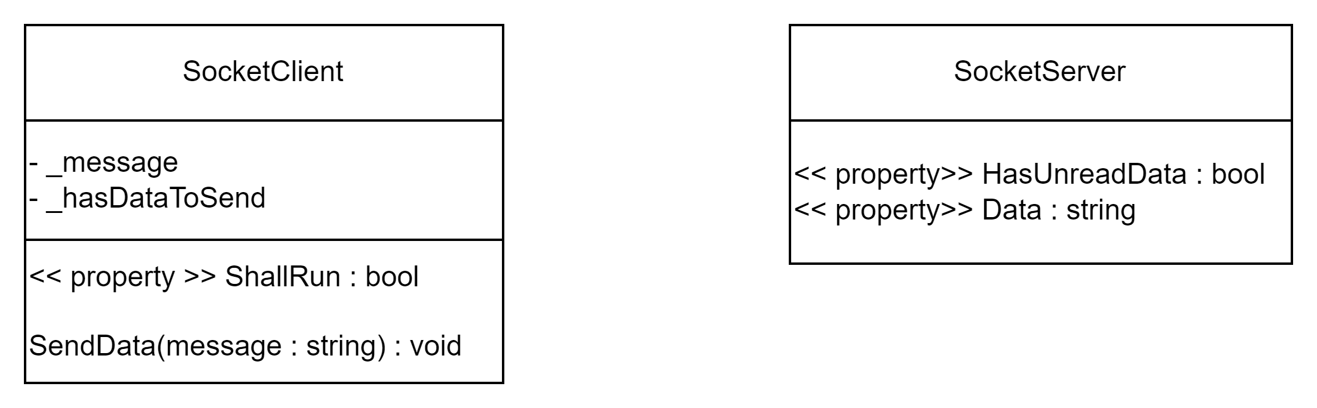
Using the socket communication from other threads
Notes:
We have added a SendData method to the client and public properties to the server, through which data can be read.

Slide 42
Sending data from the client
internal class SocketClient
{
private string _message = "";
private bool _hasDataToSend = false;
private bool _shallRun = true;
public bool ShallRun { private get => _shallRun; set => _shallRun = value; }
public void SendData(string message)
{
_message = message;
_hasDataToSend = true;
}
public void RunClient()
{
IPAddress ipAddress = IPAddress.Parse("127.0.0.1");
IPEndPoint ipEndPoint = new IPEndPoint(ipAddress, 2000);
using Socket client = new Socket(ipEndPoint.AddressFamily, SocketType.Stream, ProtocolType.Tcp);
client.Connect(ipEndPoint);
while (ShallRun)
{
// Send message.
if (_hasDataToSend)
{
var message = _message;
var messageBytes = Encoding.UTF8.GetBytes(message);
client.Send(messageBytes, SocketFlags.None);
Console.WriteLine($"Socket client sent message: {message}");
_hasDataToSend = false;
}
Thread.Sleep(0);
}
client.Shutdown(SocketShutdown.Both);
}
}

Slide 43
Sending data from the client
internal class SocketClient
{
private string _message = "";
private bool _hasDataToSend = false;
private bool _shallRun = true;
public bool ShallRun { private get => _shallRun; set => _shallRun = value; }
public void SendData(string message)
{
_message = message;
_hasDataToSend = true;
}
public void RunClient()
{
IPAddress ipAddress = IPAddress.Parse("127.0.0.1");
IPEndPoint ipEndPoint = new IPEndPoint(ipAddress, 2000);
…

Slide 44
Sending data from the client
using Socket client = new Socket(ipEndPoint.AddressFamily, SocketType.Stream, ProtocolType.Tcp);
client.Connect(ipEndPoint);
while (ShallRun)
{
// Send message.
if (_hasDataToSend)
{
var message = _message;
var messageBytes = Encoding.UTF8.GetBytes(message);
client.Send(messageBytes, SocketFlags.None);
Console.WriteLine($"Socket client sent message: {message}");
_hasDataToSend = false;
}
Thread.Sleep(0);
}
client.Shutdown(SocketShutdown.Both);
}
}

Slide 45
Receiving data on the server
internal class SocketServer
{
private bool _hasUnreadData = false;
private string _data = "";
public bool HasUnreadData { get => _hasUnreadData; private set => _hasUnreadData = value; }
public string Data
{
get
{
HasUnreadData = false;
return _data;
}
private set
{
_data = value;
HasUnreadData = true;
}
}
public void RunServer()
{
// listen to 'Any' which means all network addresses for this machine
IPAddress ipAddress = IPAddress.Any;
IPEndPoint ipEndPoint = new IPEndPoint(ipAddress, 2000);
using Socket listener = new Socket(ipEndPoint.AddressFamily, SocketType.Stream, ProtocolType.Tcp);
listener.Bind(ipEndPoint);
Console.WriteLine($"Listening on: {ipAddress}");
listener.Listen();
var handler = listener.Accept();
while (true)
{
try
{
byte[] buffer = new byte[1024];
int numberOfBytesReceived = handler.Receive(buffer, SocketFlags.None);
string receivedData = Encoding.UTF8.GetString(buffer, 0, numberOfBytesReceived);
Console.WriteLine($"Server received: {receivedData}");
Data = receivedData;
}
catch (SocketException e)
{
Console.WriteLine("Got exception: " + e.ToString());
break;
}
}
}
}

Slide 46
Receiving data on the server
internal class SocketServer
{
private bool _hasUnreadData = false;
private string _data = "";
public bool HasUnreadData { get => _hasUnreadData; private set => _hasUnreadData = value; }
public string Data
{
get
{
HasUnreadData = false;
return _data;
}
private set
{
_data = value;
HasUnreadData = true;
}
}

Slide 47
Receiving data on the server
public void RunServer()
{
// listen to 'Any' which means all network addresses for this machine
IPAddress ipAddress = IPAddress.Any;
IPEndPoint ipEndPoint = new IPEndPoint(ipAddress, 2000);
using Socket listener = new Socket(ipEndPoint.AddressFamily, SocketType.Stream, ProtocolType.Tcp);
listener.Bind(ipEndPoint);
Console.WriteLine($"Listening on: {ipAddress}");
listener.Listen();
var handler = listener.Accept();
…

Slide 48
Receiving data on the server
var handler = listener.Accept();
while (true)
{
try
{
byte[] buffer = new byte[1024];
int numberOfBytesReceived = handler.Receive(buffer, SocketFlags.None);
string receivedData = Encoding.UTF8.GetString(buffer, 0, numberOfBytesReceived);
Console.WriteLine($"Server received: {receivedData}");
Data = receivedData;
}
catch (SocketException e)
{
Console.WriteLine("Got exception: " + e.ToString());
break;
}
}
}
}

Slide 49


Slide 50
Problems in this approach
There are some problems with the way we do this:
What if SendData() is called more than once, before the data is sent on the socket?
What if SendData() is called before _hasDataToSend is reset?
What if a user of the SocketServer reads the Data property at the same time as data is received?

Slide 51
Problems in this approach
There are some problems with the way we do this:
What if SendData() is called more than once, before the data is sent on the socket?
What if SendData() is called before _hasDataToSend is reset?
What if a user of the SocketServer reads the Data property at the same time as data is received?
Some data might be lost!

Slide 52
Problems in this approach
There are some problems with the way we do this:
What if SendData() is called more than once, before the data is sent on the socket?
What if SendData() is called before _hasDataToSend is reset?
What if a user of the SocketServer reads the Data property at the same time as data is received?
We will fix this in the coming weeks ☺

Slide 53
Your turn
Solve the
” Exercise - ECG Network – Without blocking collection”

